Slide 1

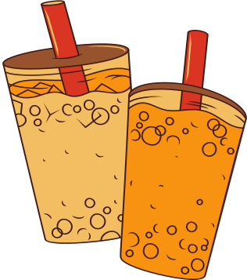
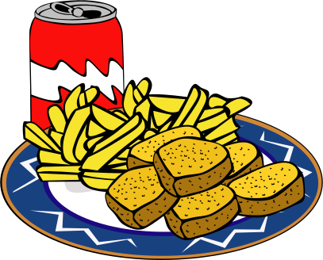
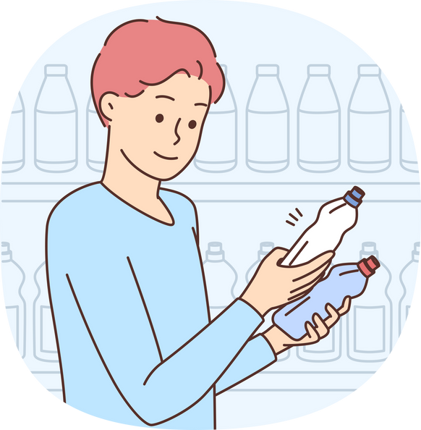
Food and Beverages Consumer Survey Analysis
Presented by Bhupal

Slide 2


Problem Statement
The objective of this Power BI project is to analyze survey responses from the food and beverage industry to gain insights into consumer behavior, preferences, and perceptions. The analysis will help identify key trends, understand brand perception, and explore potential areas for improvement in product offerings and marketing strategies.

Slide 3


Data Tables

Slide 4
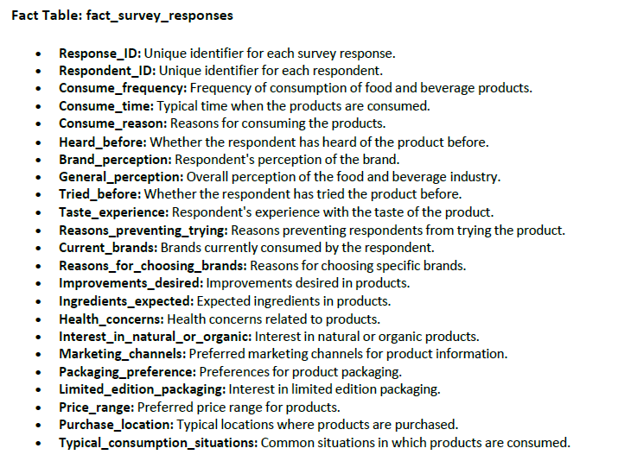
Fact_Table

Slide 5
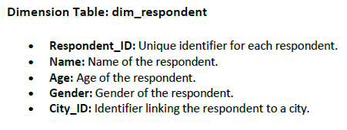
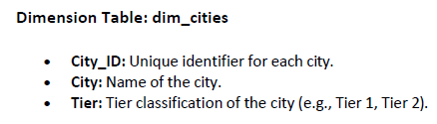
Dimension
Tables

Slide 6


Transforming Data

Slide 7


Data Cleaning Steps
Verified that all data types are correctly aligned with their respective columns.
Removed duplicate entries.
For the dim_cities table: Set the first row as headers.
Checked column quality and reviewed the column profile.

Slide 8


Data Modeling

Slide 9

Relationship Between Tables
1.Facts_Survey_responses to Dim_repondent: Many to One relationship
Each Respondent_ID in the Fact_Survey_responses table can appear multiple times, representing multiple survey responses from the same respondent.
Each Respondent_ID in the Dim_respondent table is unique representing a single repondent with a distinct ID.
2.Dim_repondent to Dim_cities: Many to One Relationship
Each Citi_ID in the Dim_respondent table can appear multiple times ,representing multiple respondents from the same city.
Each City_ID in the Dim_cities table is unique,representing a single city with a distinct ID.

Slide 10

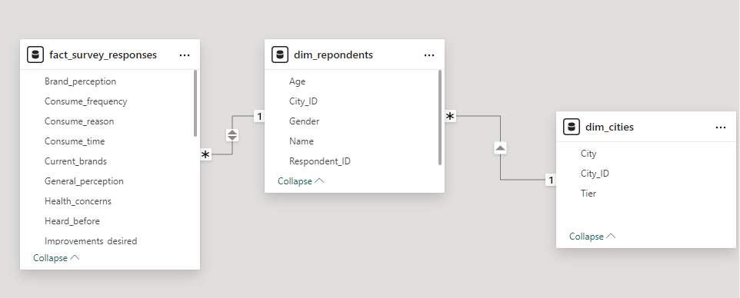
Creating Relationship between Tables

Slide 11

Data Visualization

Slide 12
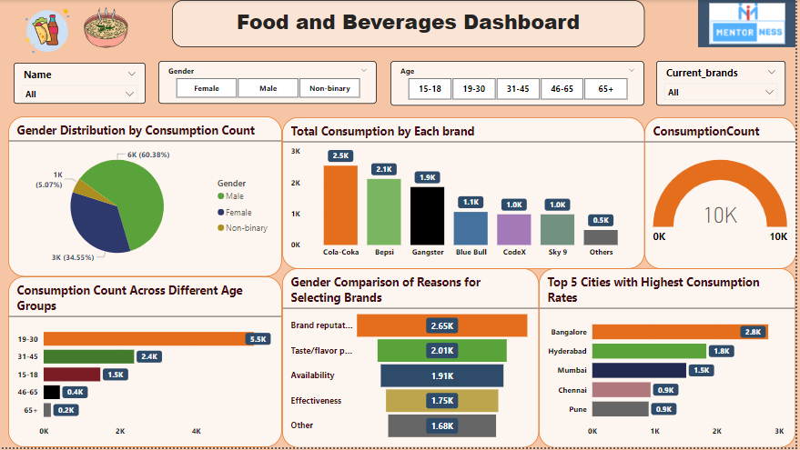

Slide 13
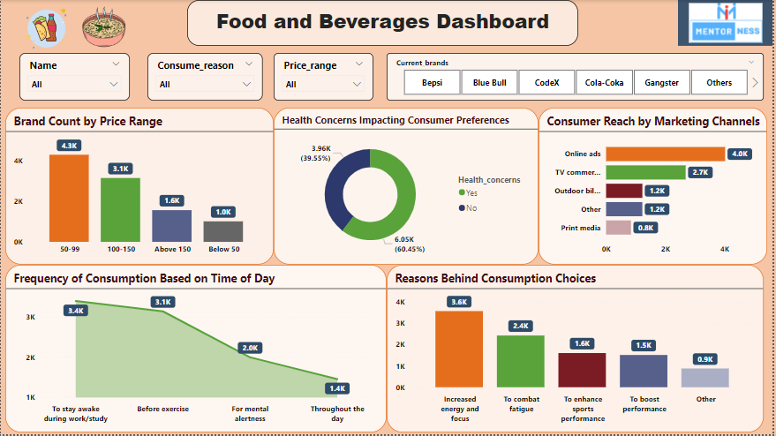

Slide 14
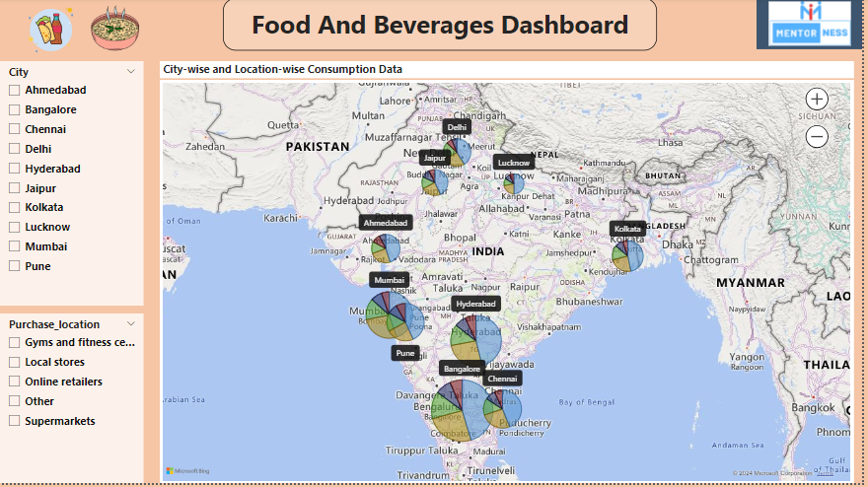

Slide 15
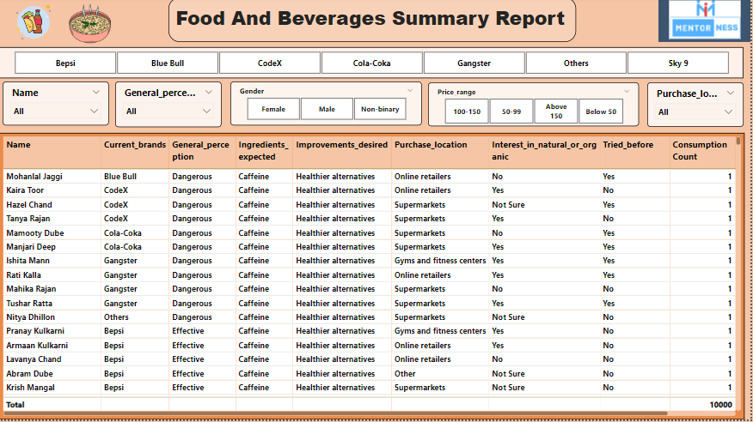

Slide 16

Key Insights:
1.Consumption Insights by Gender:
Males lead with the highest consumption at 6k, showing the most engagement, while non-binary individuals have the lowest consumption at 1k, indicating the least engagement.
2.Age Group-wisee consumption :
19 to 30 age group has the highest beverage consumption at 5.5k, showing strong engagement. In contrast, the 65+ age group has the lowest consumption at 0.2k, indicating less frequent use.
3.Brand Selection Reason
The majority of consumers, 2.65k, choose brands based on brand reputation, while 1.68k select brands for other reasons. This highlights the strong influence of reputation in consumer decision-making.

Slide 17
Key Insights:
4.Health Concerns Impacting Consumer Preferences:
Most consumers (60.45%) prioritize health in their choices, while 39.55% don’t, showing a strong demand for health-conscious products but still some interest in traditional options
5.Brand Consumption Insight:
Cola Coka leads as the most consumed brand with 2.5k, while all other brands combined have a lower consumption of 0.5k, highlighting Cola Coka's dominance in the market.
6.Consuming Frequency:
Brand consumption is significantly higher during study or awake periods compared to regular daily use.
7. The highest consumption is for increasing energy and focus (3.6K), while the lowest is for other diverse reasons (0.9K).

Slide 18

Suggestions
1.Expand Product Lines:
Launch new healthy and organic products, and consider seasonal or special edition flavors.
2.Targeted Marketing:
Tailor marketing to different age groups—highlight new and unique flavors for younger consumers, and focus on quality and tradition for older ones.
3.Enhance Customer Service:
Improve customer service with better training and regular feedback reviews.
4. Adjust Pricing Strategies:
Use tiered pricing for premium vs. standard products and offer value packs or loyalty rewards.
5. Act on Feedback:
Update products and packaging based on customer feedback and review it regularly.
6. Monitor Trends:
Keep an eye on market trends and adjust your strategies to stay current.

Slide 19

Thank you
Bhupal Maruchetty

